Slide 1

Virtual Roll Call 3.0
Team Member(s): Juan Lopez, Jean Faustin Product Owner: Jason Cohen, Frank Alvarado
Instructor: Masoud Sadjadi School of Computing and Information Sciences Florida International University
Final Presentation
Fall 2017
Notes:
7 seconds.( I will select 2 best slides (i will give them extra points and students will present for CIS committee)
Greet your audience, thank them for attending your presentation, introduce yourself, introduce your project, introduce your team members, and quickly indicate what each of you did in a high-level manner, and put more emphasis on your part/contribution.

Slide 2
Project definition
Roll call is a briefing meeting in police departments where shift supervisors share critical information with officers.
Officers cannot always be present for these briefings, preventing them from receiving vital information.
It can be difficult for supervisors to distribute new material to officers after roll call is over
Notes:
10 seconds.
Introduce the problem that the whole project (in all versions) tackles with GIF or screenshot.

Slide 3
Solution
The Virtual Roll Call (VRC) web application solves the following problems:
Eliminates the need for in person roll calls
Allows officers to receive information in real-time
Verifies that officers have reviewed required documents
Notes:
10 seconds.
Introduce the problem that the whole project (in all versions) tackles with GIF or screenshot.

Slide 4
Users
Administrators
Supervisors
Officers

Slide 5
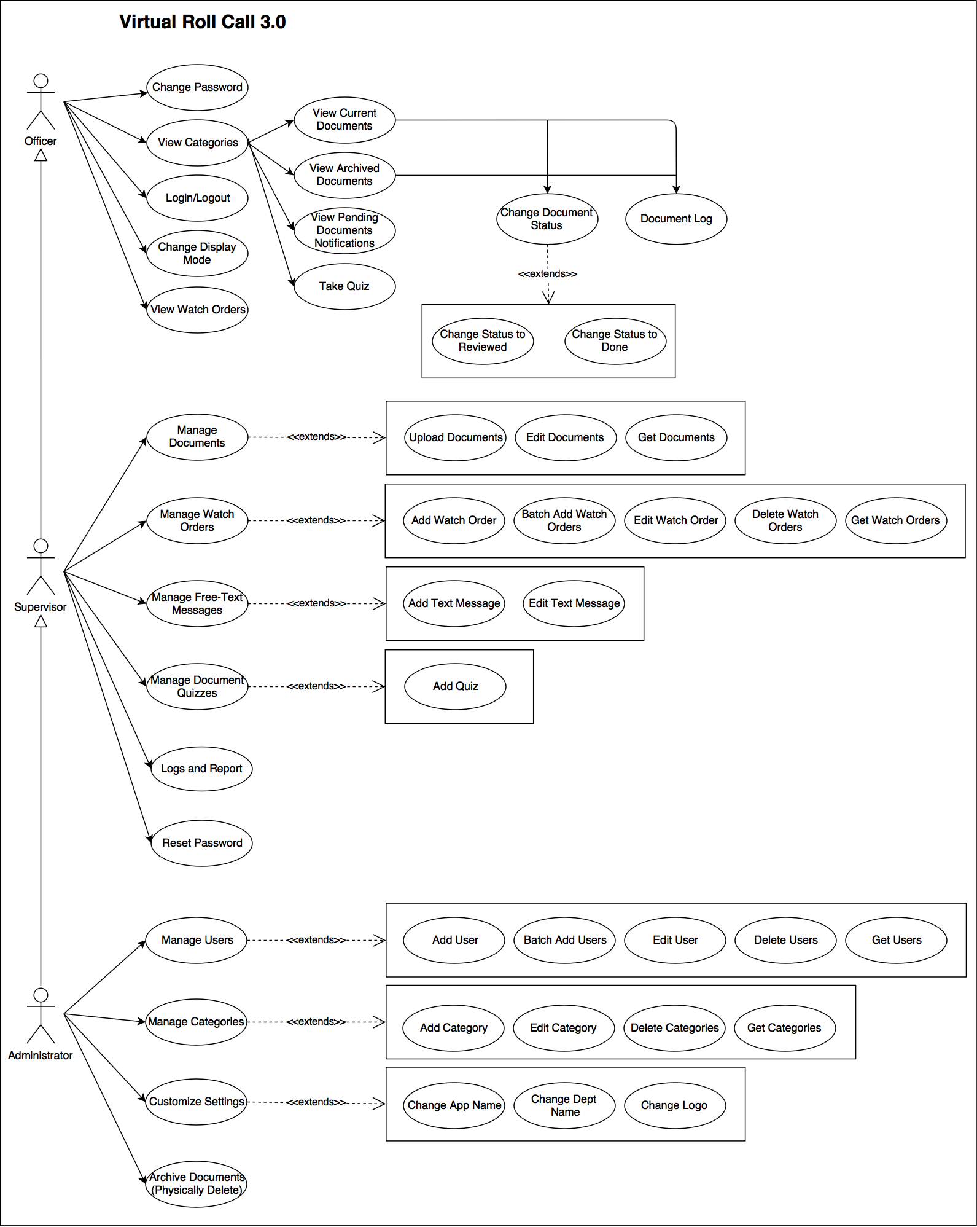
Requirements: Use Cases
Notes:
5 seconds
Show the Use Case Diagram for the whole project. Highlight your use cases.

Slide 6
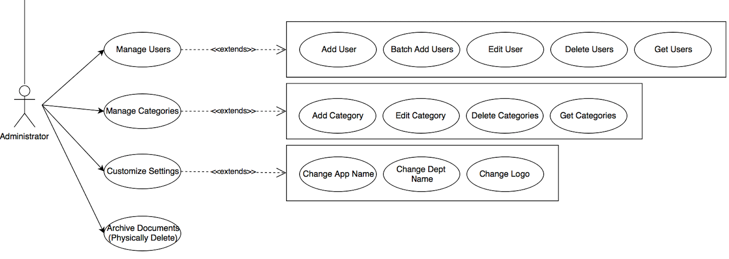
Requirements: Use Cases
Notes:
5 seconds
Show the Use Case Diagram for the whole project. Highlight your use cases.

Slide 7
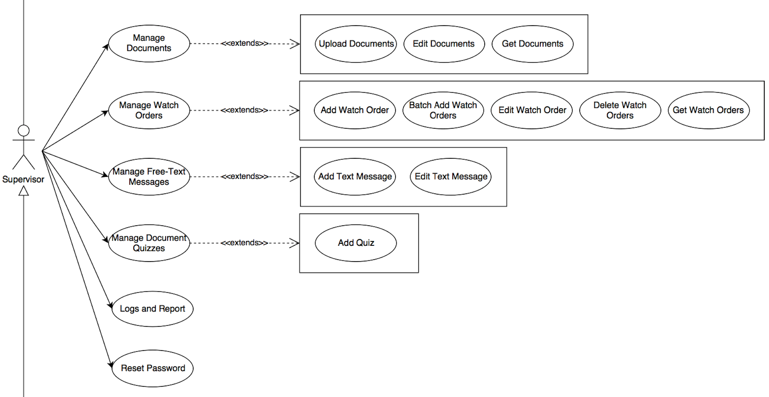
Requirements: Use Cases
Notes:
5 seconds
Show the Use Case Diagram for the whole project. Highlight your use cases.

Slide 8
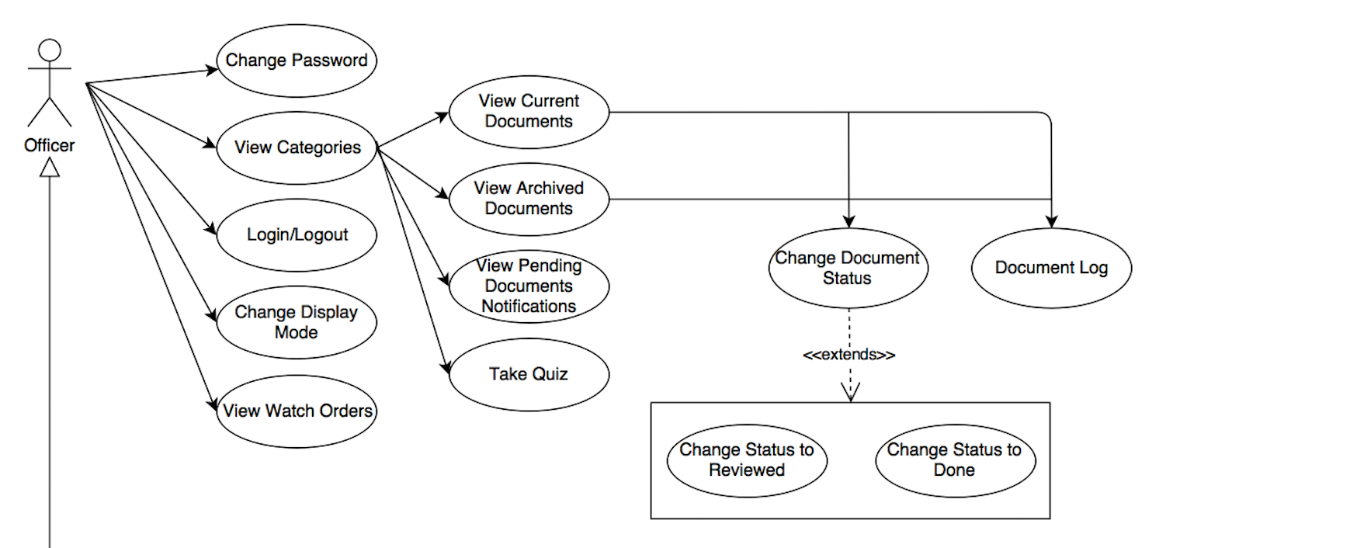
Requirements: Use Cases
Notes:
5 seconds
Show the Use Case Diagram for the whole project. Highlight your use cases.

Slide 9
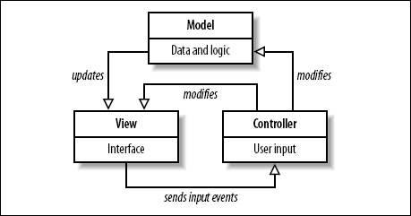
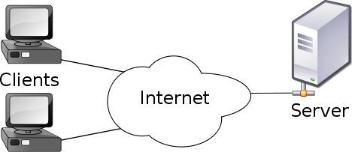
System Design: Architecture
Model-View Controller
Model-View-Controller is an architectural pattern commonly used for designing web applications. As the name implies, there are 3 major components in the architecture:
1. Model – manages the data and logic of the application
2. View – The User Interface of the application
3. Controller – Receives user input and modifies data in the model
Client-Server Model
Our system uses the Client-Server model, which is an application structure used in distributed applications. The client makes requests to the server via the internet,, and the server responds to the client with the requested function. Virtual Roll Call is hosted on a Linux Ubuntu virtual machine, and clients are able to use the application and perform actions through the server.
Notes:
20 seconds
System design: Highlight the parts that you contributed to them.
1. System decomposition; identify the architecture patterns used
2. System deployment – h/w and s/w requirements

Slide 10
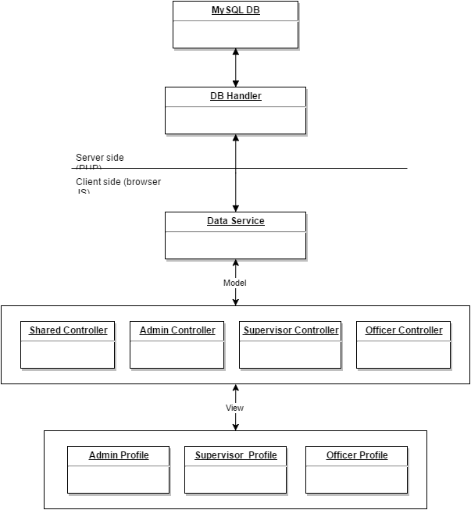
Minimal Class Diagram
Notes:
10 seconds.Minimal class diagram. Highlight the classes that you created/modified
Identify the design patterns used (one or more slides).

Slide 11
18 User Stories
• User Story 147: Lock User
• User Story 300: Improve Document List Presentation
• User Story 241: Add Users with CSV File
• User Story 242: Change Display Mode
• User Story 243: Add Document Quiz
• User Story 246: Add Watch Orders with CSV File
• User Story 247: View Watch Orders on Map
• User Story 248: Add Text Information
• User Story 250: Add Password Encryption
Notes:
5 seconds.
List the user stories that you worked on them.(put in order of importance). Stay focused on the parts that you have been working.

Slide 12
User Stories
• User Story 250: Add Password Encryption
• User Story 295: Display Documents within Website
• User Story 296: Display Pending Documents Notification
• User Story 301: Application Distribution Package
• User Story 300: Improve Document List Presentation
• User Story 302: Change Navigation Bar Based on User Role
• User Story 304: Add Watch Order
• User Story 306: Delete Watch Order
• User Story 307: Edit Watch Order
Notes:
5 seconds.
List the user stories that you worked on them.(put in order of importance). Stay focused on the parts that you have been working.

Slide 13
User Stories
• User Story 308: Edit Free Message
• User Story 309: Automatically Delete Watch Orders
• User Story 310: Display Watch Order List Table
• User Story 312: Take Quiz
Notes:
5 seconds.
List the user stories that you worked on them.(put in order of importance). Stay focused on the parts that you have been working.

Slide 14
Sprint 2
Juan Lopez
Story # 242: Change Display Mode
Story # 296: Pending Document Notification
Jean Faustin
Story # 295: Display Documents within Website

Slide 15
User Story #242 Change Display Mode
As an officer, I would like to switch the display to either night or day mode so that I can view the site in lighter colors during the day and darker colors during the night.
1. There must be an option in the website header dropdown to manually change the display mode.
2. When night-mode is activated, only dark colors should be used throughout the site.
3. When day-mode is activated, the normal colors (lighter) should be used throughout the site.
4. The user’s display mode preference should be saved so that the display mode is consistent in all pages.
5. When the users logs off, the display mode will be reset to day-mode.
Notes:
60 seconds
The tile of user story
The most important user story you worked on it. You have to describe this one very well and be proud of that.
Please present and show the complexity of your work, code, algorithms, and technical challenges and technologies you have used. (you could use screenshot if you want. Visual presentations are better than text presentation)
Go into the details of the most important/significant tasks using bullet lists or visual graphs or state chart diagram
Sequence Diagram for this user story is mandatory (in another separate page if required)
Demo using screenshots or GIF (in another separate page if required)

Slide 16
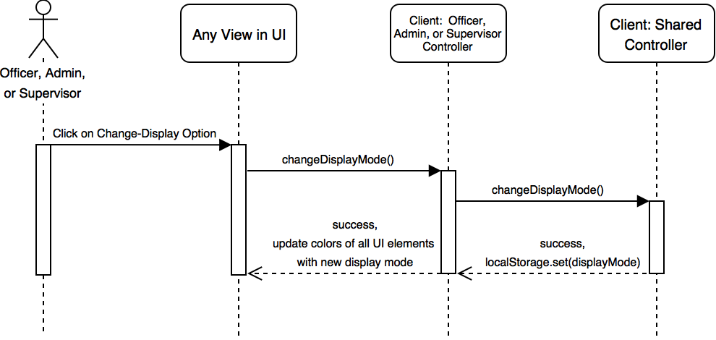

Slide 17
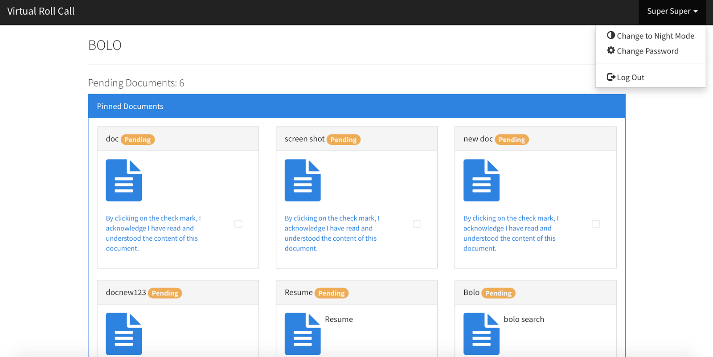
Notes:
20 seconds
The tile of user story
Please present and show the complexity of your work, code, algorithms, and technical challenges and technologies you have used. (you could use screenshot if you want. Visual presentations are better than text presentation) - Go into the details of the most important/significant tasks using bullet lists or visual graphs or state chart diagram - Demo using screenshots or GIF (in another separate page if required)
Sequence Diagram for this user story is optional

Slide 18
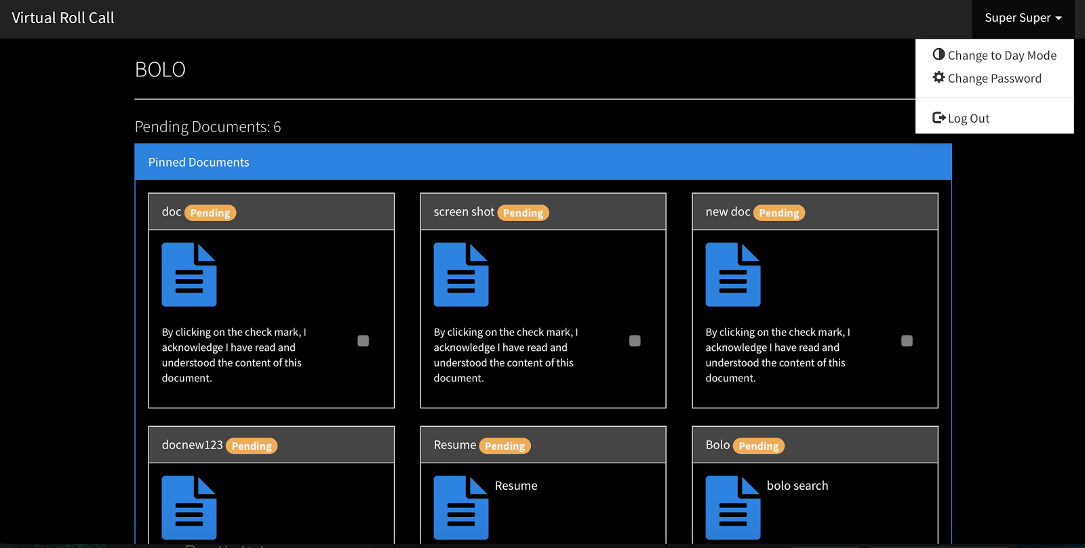
Notes:
20 seconds
The tile of user story
Please present and show the complexity of your work, code, algorithms, and technical challenges and technologies you have used. (you could use screenshot if you want. Visual presentations are better than text presentation) - Go into the details of the most important/significant tasks using bullet lists or visual graphs or state chart diagram - Demo using screenshots or GIF (in another separate page if required)
Sequence Diagram for this user story is optional

Slide 19
User Story #296:Display Pending Documents Notification
As an officer, I would like to view a notification badge in the main document page that shows the number of pending document per document category so that I can quickly identify which categories contain pending documents.
When the user views the main document page, a notification badge will be displayed for each document category that shows the total number of pending documents per category
When the status of a document changes, it must be reflected in the notification badge.
If there are no pending documents for the category, there must be no notification badge displayed.
The notification badge must be easily readable and in accordance with the rest of site’s style.
When the users logs off, the display mode will be reset to day-mode.
Notes:
60 seconds
The tile of user story
The most important user story you worked on it. You have to describe this one very well and be proud of that.
Please present and show the complexity of your work, code, algorithms, and technical challenges and technologies you have used. (you could use screenshot if you want. Visual presentations are better than text presentation)
Go into the details of the most important/significant tasks using bullet lists or visual graphs or state chart diagram
Sequence Diagram for this user story is mandatory (in another separate page if required)
Demo using screenshots or GIF (in another separate page if required)

Slide 20
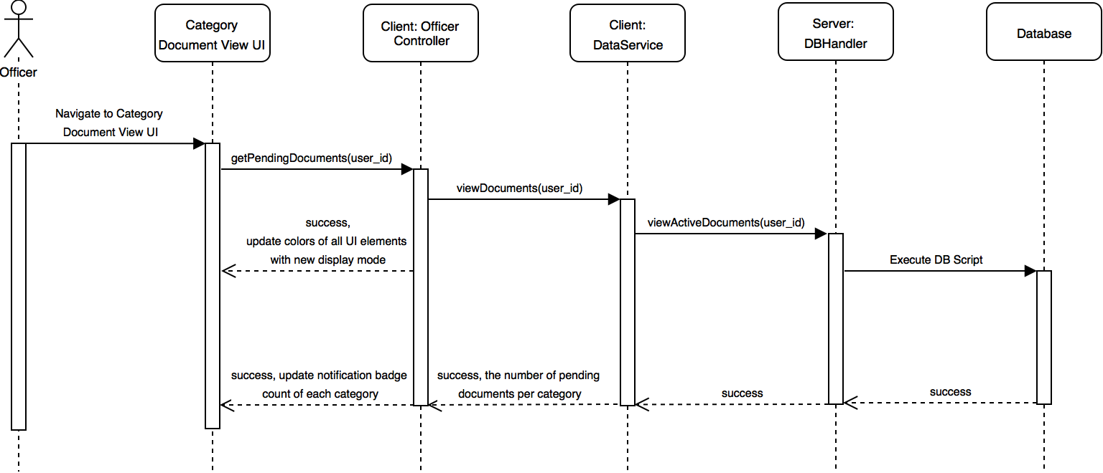

Slide 21
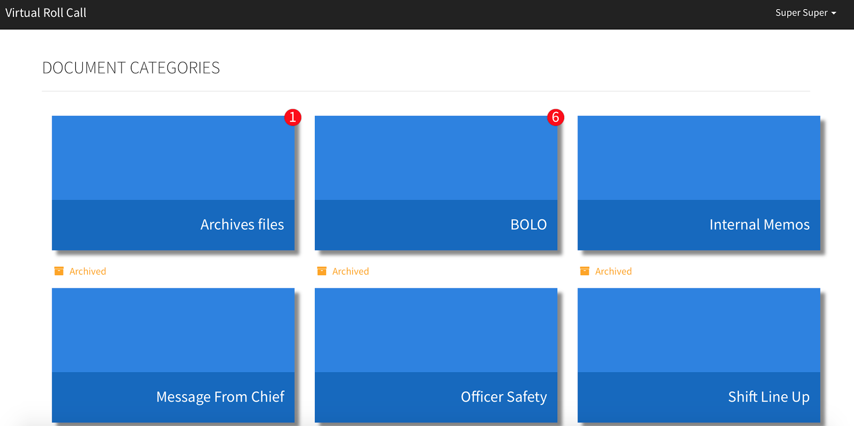
Notes:
20 seconds
The tile of user story
Please present and show the complexity of your work, code, algorithms, and technical challenges and technologies you have used. (you could use screenshot if you want. Visual presentations are better than text presentation) - Go into the details of the most important/significant tasks using bullet lists or visual graphs or state chart diagram - Demo using screenshots or GIF (in another separate page if required)
Sequence Diagram for this user story is optional

Slide 22
User Story #295:
Display documents within window.
As an officer, I would like to view my documents and images within the same window as a popup
The user has logged into the system.
The user has selected the document category to view corresponding documents.
If there are no pending documents for the category, no window should open.
Documents PDF or Image (.jpg, png) versions are stored and available from the database and saved on the “uploads” folder.
Notes:
60 seconds
The tile of user story
The most important user story you worked on it. You have to describe this one very well and be proud of that.
Please present and show the complexity of your work, code, algorithms, and technical challenges and technologies you have used. (you could use screenshot if you want. Visual presentations are better than text presentation)
Go into the details of the most important/significant tasks using bullet lists or visual graphs or state chart diagram
Sequence Diagram for this user story is mandatory (in another separate page if required)
Demo using screenshots or GIF (in another separate page if required)

Slide 23
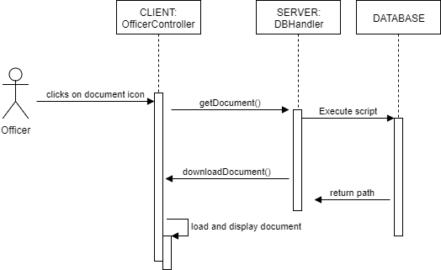
Insert sequence diagram

Slide 24
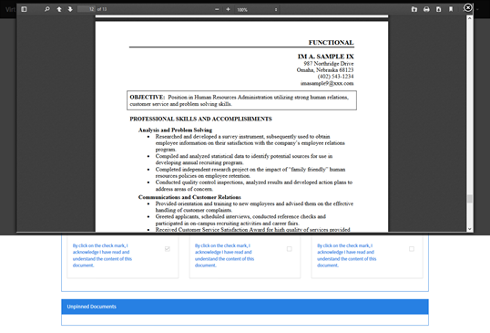
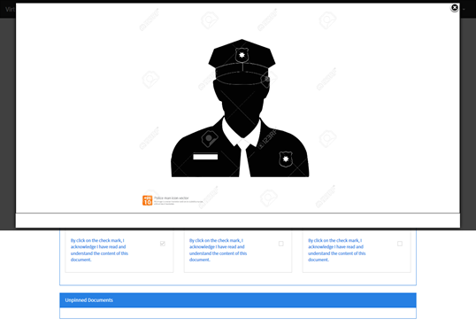
Insert screenshot
Notes:
20 seconds
The tile of user story
Please present and show the complexity of your work, code, algorithms, and technical challenges and technologies you have used. (you could use screenshot if you want. Visual presentations are better than text presentation) - Go into the details of the most important/significant tasks using bullet lists or visual graphs or state chart diagram - Demo using screenshots or GIF (in another separate page if required)
Sequence Diagram for this user story is optional

Slide 25
Sprint 3
Juan Lopez
Story # 241: Add Users with CSV File
Story # 300: Improve Document List Presentation
Jean Faustin
Story # 147: Lock User
Story # 250: Add Password Encryption

Slide 26
User Story #241: Add Users with CSV File
As an administrator, I would like to be able to add multiple users in one batch using a CSV file so that I don’t have to manually add each user one at a time.
The result of parsing a CSV file must be displayed in a table of imported users.
The system must only accept CSV files, other files must be rejected with a warning.
If no CSV file is selected, the system will warn the user.
The admin must be able to edit the information of any imported user before the user is added to the database.
The admin must be able to delete any imported user before it is added.
If a user cannot be added to the database, the system must display an error message and the admin will be able to edit any rejected user and try again.
Notes:
60 seconds
The tile of user story
The most important user story you worked on it. You have to describe this one very well and be proud of that.
Please present and show the complexity of your work, code, algorithms, and technical challenges and technologies you have used. (you could use screenshot if you want. Visual presentations are better than text presentation)
Go into the details of the most important/significant tasks using bullet lists or visual graphs or state chart diagram
Sequence Diagram for this user story is mandatory (in another separate page if required)
Demo using screenshots or GIF (in another separate page if required)

Slide 27
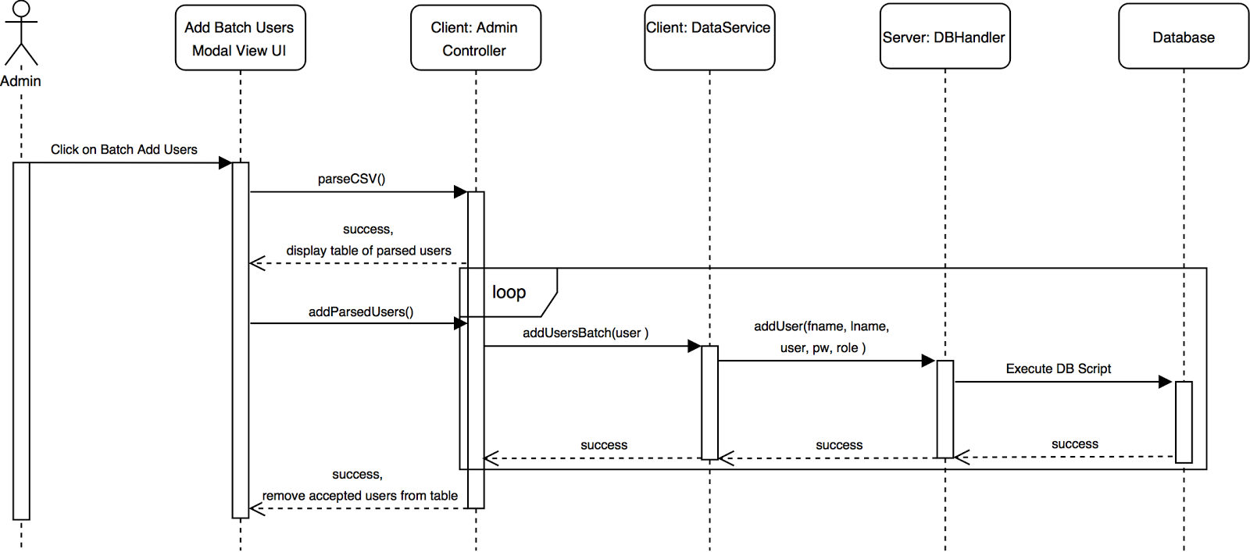

Slide 28
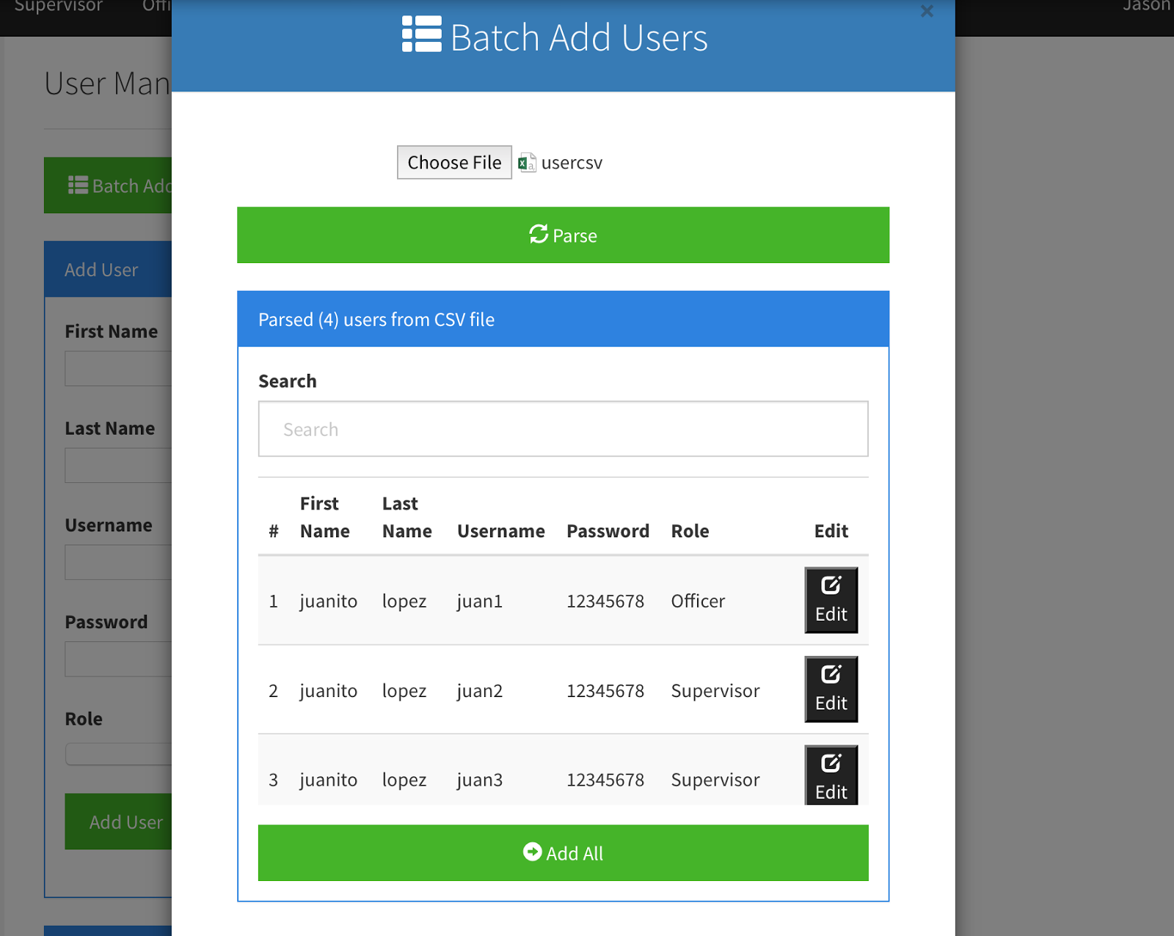
Notes:
20 seconds
The tile of user story
Please present and show the complexity of your work, code, algorithms, and technical challenges and technologies you have used. (you could use screenshot if you want. Visual presentations are better than text presentation) - Go into the details of the most important/significant tasks using bullet lists or visual graphs or state chart diagram - Demo using screenshots or GIF (in another separate page if required)
Sequence Diagram for this user story is optional

Slide 29
User Story #300: Improve Document List Presentation
As an officer, I would like to view an improved document list where documents have been ordered by their status and have different color labels so that I can easily distinguish between the different types of documents.
In the document list view, documents must be grouped by their status.
Pending documents must appear first, followed by Reviewed documents, and lastly Done documents.
Pending documents must have a red status label.
Reviewed document must have an orange status label.
Done documents must have a green status label.
The color of the document status label must update when the status of the document changes.
Notes:
60 seconds
The tile of user story
The most important user story you worked on it. You have to describe this one very well and be proud of that.
Please present and show the complexity of your work, code, algorithms, and technical challenges and technologies you have used. (you could use screenshot if you want. Visual presentations are better than text presentation)
Go into the details of the most important/significant tasks using bullet lists or visual graphs or state chart diagram
Sequence Diagram for this user story is mandatory (in another separate page if required)
Demo using screenshots or GIF (in another separate page if required)

Slide 30
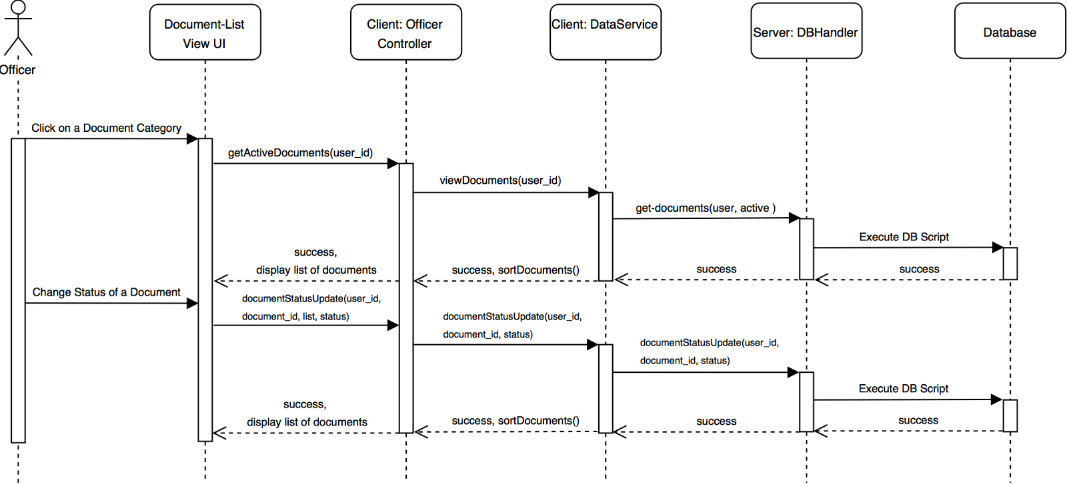

Slide 31
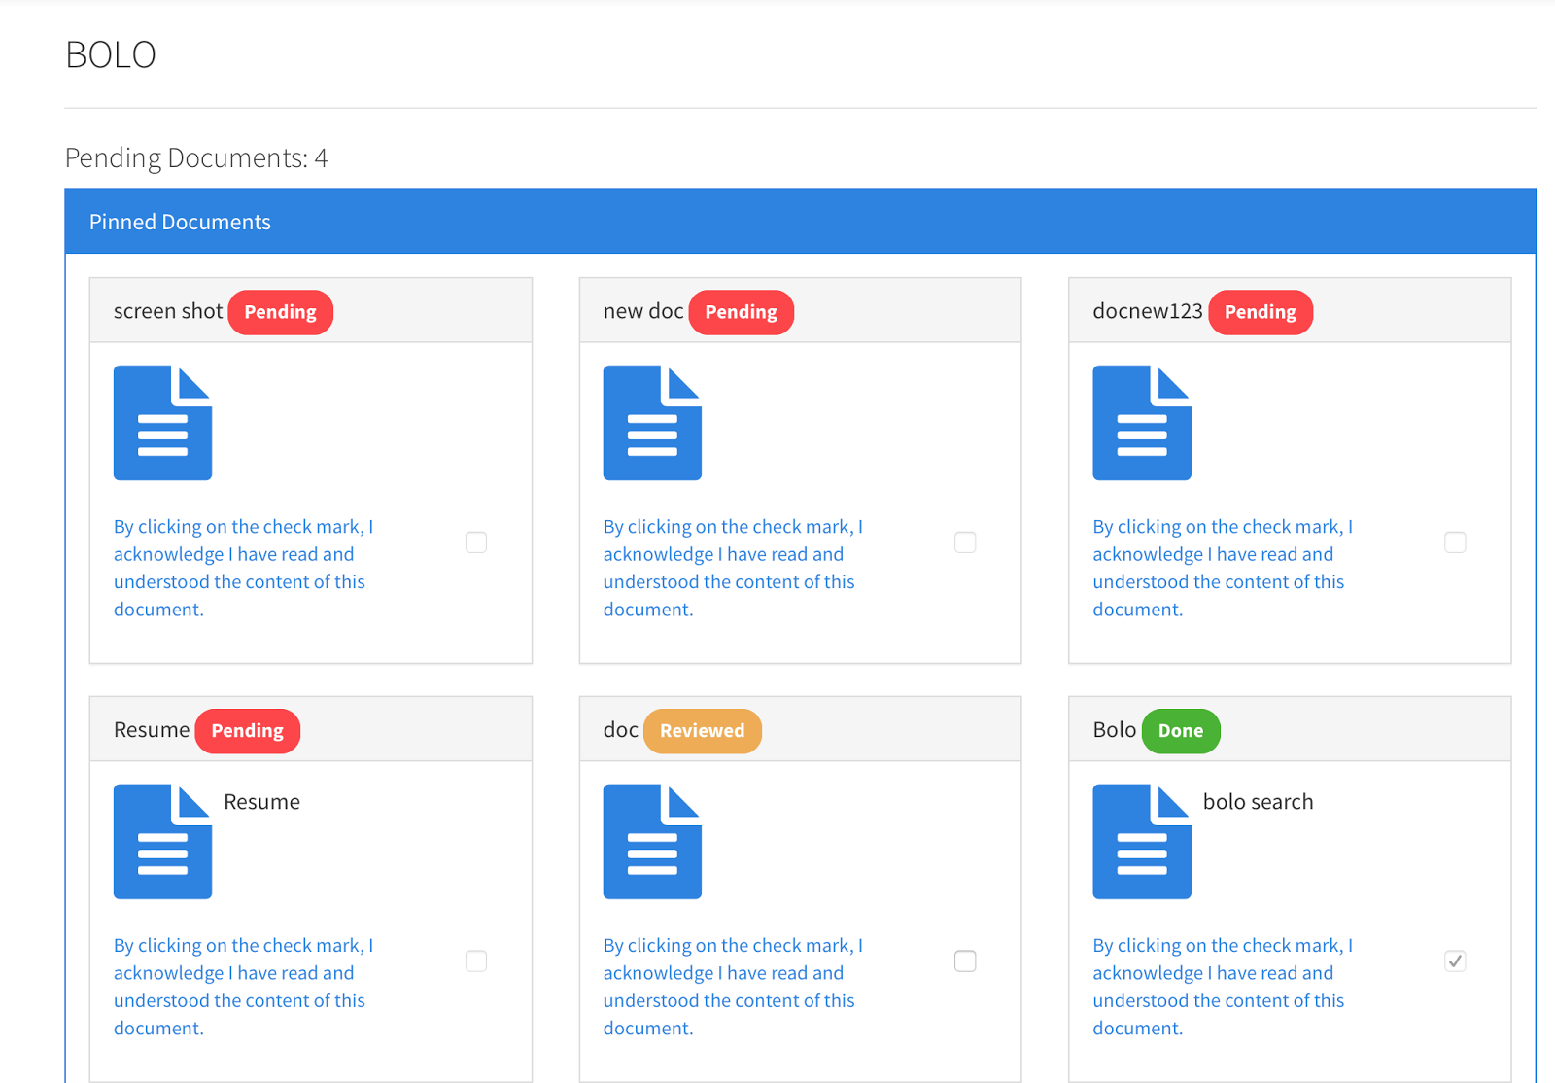
Notes:
20 seconds
The tile of user story
Please present and show the complexity of your work, code, algorithms, and technical challenges and technologies you have used. (you could use screenshot if you want. Visual presentations are better than text presentation) - Go into the details of the most important/significant tasks using bullet lists or visual graphs or state chart diagram - Demo using screenshots or GIF (in another separate page if required)
Sequence Diagram for this user story is optional

Slide 32
User Story #147:
Lock User after Consecutive Failed Attempts.
As an officer, I want my account to be locked after five consecutive login attempts, so that they system does not get hacked.
The system should lock the account after five attempts.
If I enter incorrect credentials, I should see an appropriate response message with the remaining available attempts.
I should be able to retry authentication myself after the third time with a stronger warning and must reset my password to unlock my account.
A notification must be sent to my manager upon account lockout.
Notes:
60 seconds
The tile of user story
The most important user story you worked on it. You have to describe this one very well and be proud of that.
Please present and show the complexity of your work, code, algorithms, and technical challenges and technologies you have used. (you could use screenshot if you want. Visual presentations are better than text presentation)
Go into the details of the most important/significant tasks using bullet lists or visual graphs or state chart diagram
Sequence Diagram for this user story is mandatory (in another separate page if required)
Demo using screenshots or GIF (in another separate page if required)

Slide 33
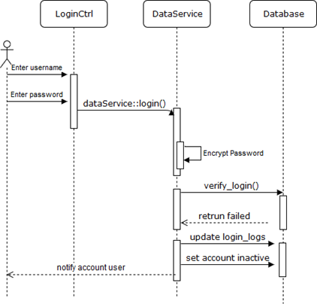
Insert sequence diagram

Slide 34
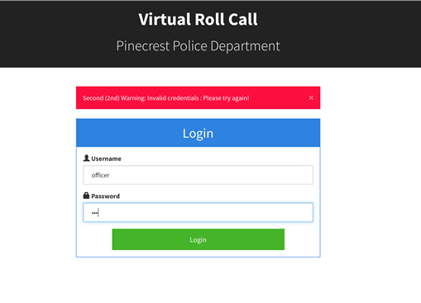
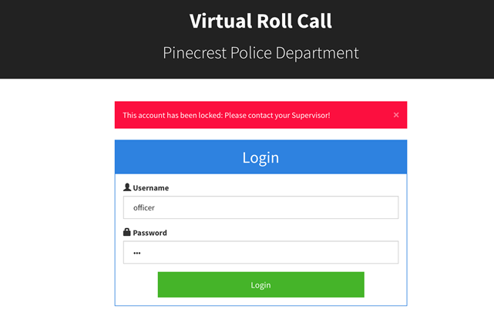
Insert screenshot
Notes:
20 seconds
The tile of user story
Please present and show the complexity of your work, code, algorithms, and technical challenges and technologies you have used. (you could use screenshot if you want. Visual presentations are better than text presentation) - Go into the details of the most important/significant tasks using bullet lists or visual graphs or state chart diagram - Demo using screenshots or GIF (in another separate page if required)
Sequence Diagram for this user story is optional

Slide 35
User Story #250: Password Encryption.
As an administrator, I would like the system to encrypt my password to increase protection.
The database should not allow anyone to guess how long and the format for passwords.
Passwords are alpha-numeric only.
Encrypt sensitive data such as login credentials for access. If user has forgotten password, must have Supervisor to reset password.
Notes:
60 seconds
The tile of user story
The most important user story you worked on it. You have to describe this one very well and be proud of that.
Please present and show the complexity of your work, code, algorithms, and technical challenges and technologies you have used. (you could use screenshot if you want. Visual presentations are better than text presentation)
Go into the details of the most important/significant tasks using bullet lists or visual graphs or state chart diagram
Sequence Diagram for this user story is mandatory (in another separate page if required)
Demo using screenshots or GIF (in another separate page if required)

Slide 36
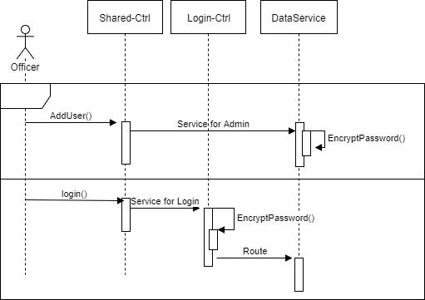
Insert sequence diagram

Slide 37
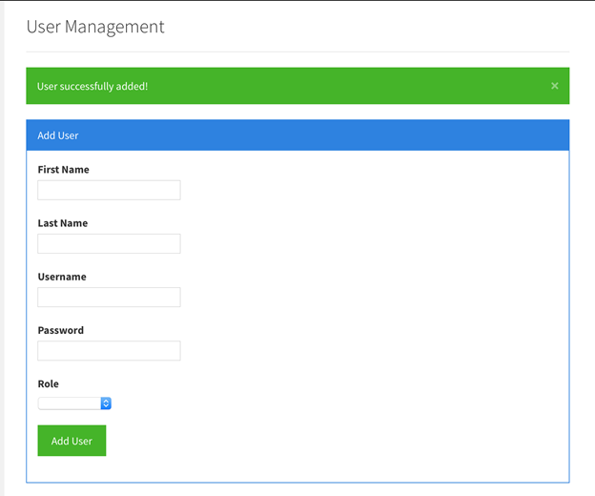
Insert screenshot
Notes:
20 seconds
The tile of user story
Please present and show the complexity of your work, code, algorithms, and technical challenges and technologies you have used. (you could use screenshot if you want. Visual presentations are better than text presentation) - Go into the details of the most important/significant tasks using bullet lists or visual graphs or state chart diagram - Demo using screenshots or GIF (in another separate page if required)
Sequence Diagram for this user story is optional

Slide 38
Sprint 4
Juan Lopez
Story # 246: Add Watch Orders with CSV File
Story # 247: View Watch Orders on Map
Jean Faustin
Story # 301: Application Distribution Package
Story # 302: Change Navigation Bar Based on User Role

Slide 39
User Story #246: Add Watch Orders with CSV File
As a supervisor, I would like to add watch orders into the system with a CSV file so that they can later be viewed in a map by officers.
The result of parsing a CSV file must be displayed in a table of imported watch orders.
The system must only accept CSV files, other files must be rejected with a warning.
The supervisor must be able to edit the information of any imported watch order before the user is added to the database.
If a watch order cannot be added to the database, the system must display an error message, and the supervisor will be able to edit any rejected watch order and try again.
When the supervisor adds a CSV file, it will overwrite any existing watch orders.
Notes:
60 seconds
The tile of user story
The most important user story you worked on it. You have to describe this one very well and be proud of that.
Please present and show the complexity of your work, code, algorithms, and technical challenges and technologies you have used. (you could use screenshot if you want. Visual presentations are better than text presentation)
Go into the details of the most important/significant tasks using bullet lists or visual graphs or state chart diagram
Sequence Diagram for this user story is mandatory (in another separate page if required)
Demo using screenshots or GIF (in another separate page if required)

Slide 40
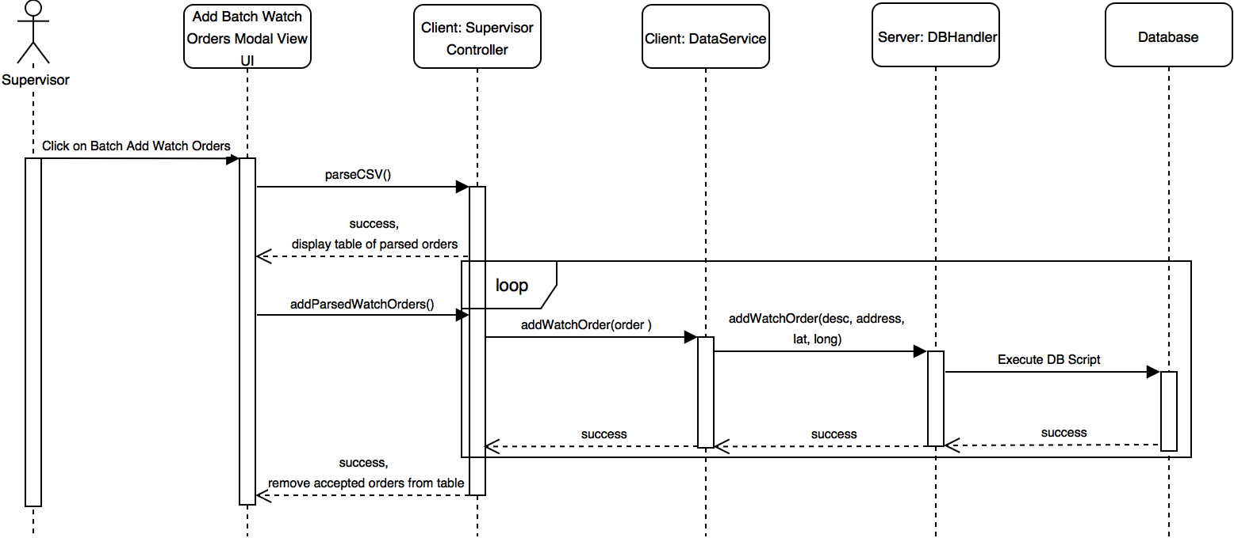

Slide 41
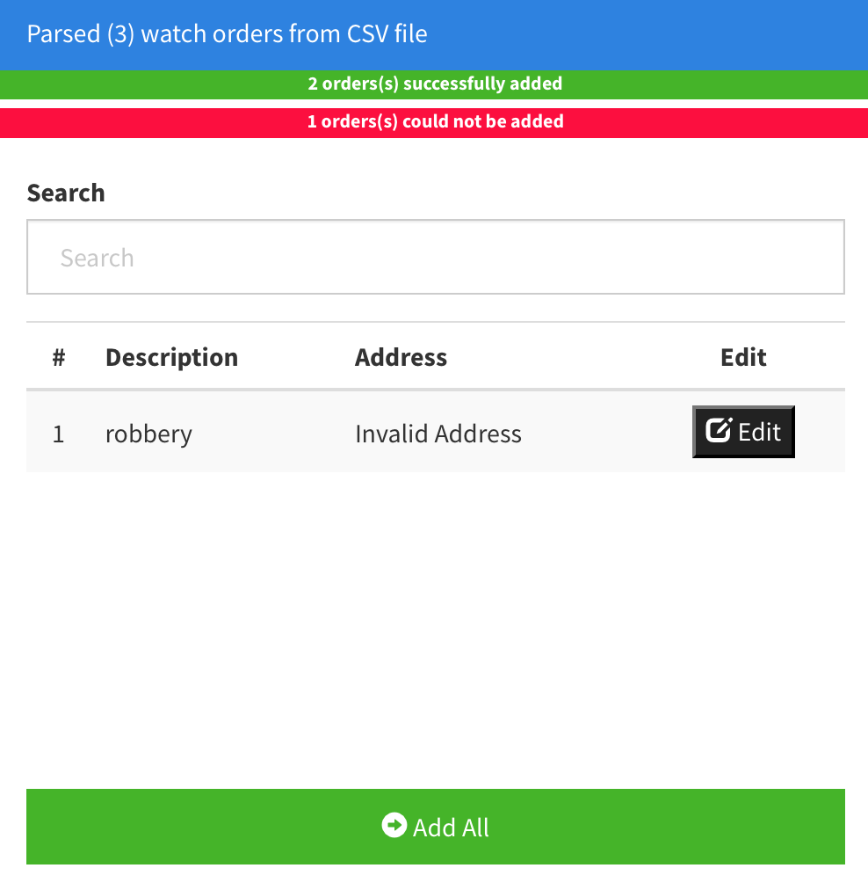
Notes:
20 seconds
The tile of user story
Please present and show the complexity of your work, code, algorithms, and technical challenges and technologies you have used. (you could use screenshot if you want. Visual presentations are better than text presentation) - Go into the details of the most important/significant tasks using bullet lists or visual graphs or state chart diagram - Demo using screenshots or GIF (in another separate page if required)
Sequence Diagram for this user story is optional

Slide 42
User Story #247: View Watch Orders on Map
As an officer, I would like to view all the watch orders on a map so that I can plan my visitation routes accordingly.
Each watch order should be displayed on a map as a marker.
The location of each marker will be determined by longitude and latitude properties of each watch order.
When the user clicks a marker, the description and date will be displayed in an information window.
If there are no watch orders, no markers will be displayed.
If a watch order cannot be added to the database, the system must display an error message, and the supervisor will be able to edit any rejected watch order and try again.
When the supervisor adds a CSV file, it will overwrite any existing watch orders.
Notes:
60 seconds
The tile of user story
The most important user story you worked on it. You have to describe this one very well and be proud of that.
Please present and show the complexity of your work, code, algorithms, and technical challenges and technologies you have used. (you could use screenshot if you want. Visual presentations are better than text presentation)
Go into the details of the most important/significant tasks using bullet lists or visual graphs or state chart diagram
Sequence Diagram for this user story is mandatory (in another separate page if required)
Demo using screenshots or GIF (in another separate page if required)

Slide 43
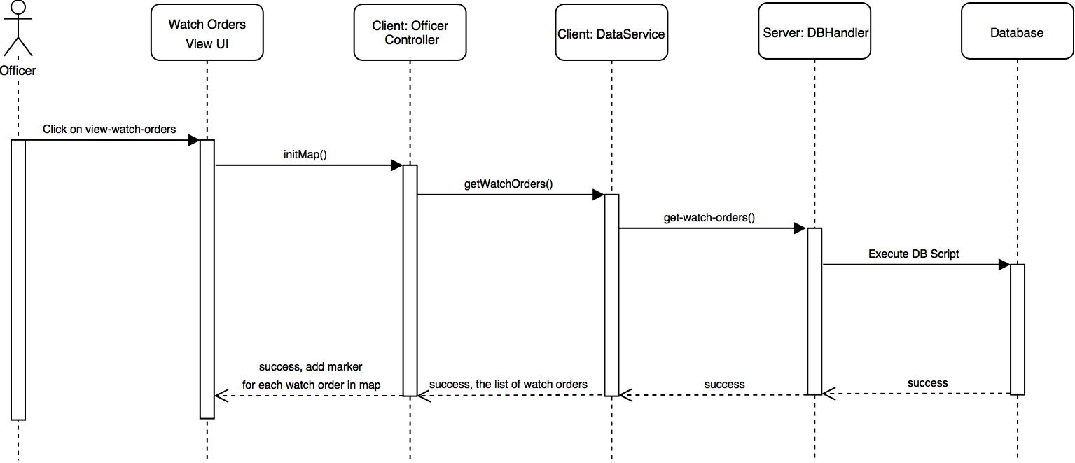

Slide 44
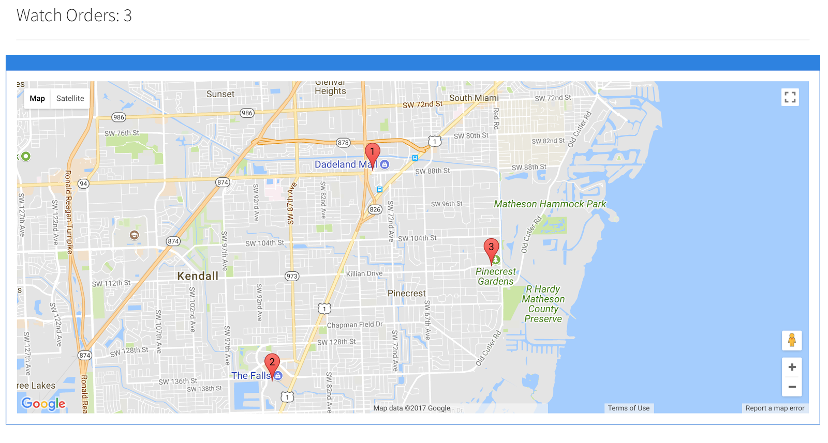
Notes:
20 seconds
The tile of user story
Please present and show the complexity of your work, code, algorithms, and technical challenges and technologies you have used. (you could use screenshot if you want. Visual presentations are better than text presentation) - Go into the details of the most important/significant tasks using bullet lists or visual graphs or state chart diagram - Demo using screenshots or GIF (in another separate page if required)
Sequence Diagram for this user story is optional

Slide 45
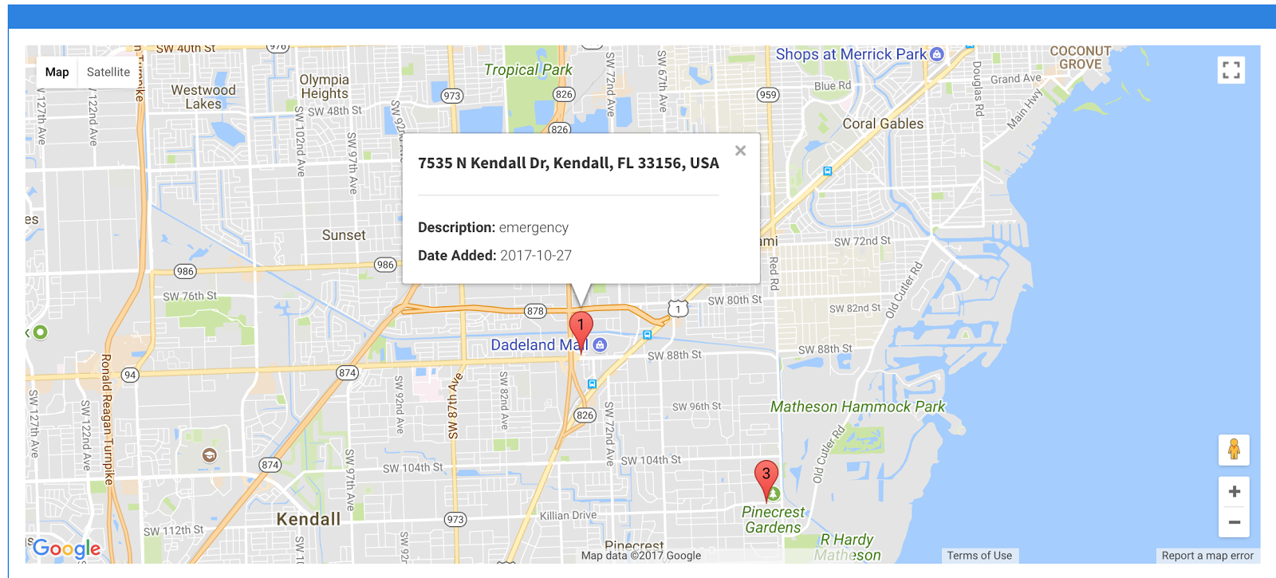
Notes:
20 seconds
The tile of user story
Please present and show the complexity of your work, code, algorithms, and technical challenges and technologies you have used. (you could use screenshot if you want. Visual presentations are better than text presentation) - Go into the details of the most important/significant tasks using bullet lists or visual graphs or state chart diagram - Demo using screenshots or GIF (in another separate page if required)
Sequence Diagram for this user story is optional

Slide 46
User Story #302:
Change Navigation Bar Based on User Role
As an administrator or supervisor, I want to navigate between roles without opening a new browser to help better and faster accessing information.
The system should allow an administrator to jump between administrator, supervisor and officer role.
The system should allow a supervisor to navigate between supervisor and officer roles.
The system should allow an officer not to navigate between document categories.
The system should allow non-administrator or non-supervisor to only view officer role.
Notes:
60 seconds
The tile of user story
The most important user story you worked on it. You have to describe this one very well and be proud of that.
Please present and show the complexity of your work, code, algorithms, and technical challenges and technologies you have used. (you could use screenshot if you want. Visual presentations are better than text presentation)
Go into the details of the most important/significant tasks using bullet lists or visual graphs or state chart diagram
Sequence Diagram for this user story is mandatory (in another separate page if required)
Demo using screenshots or GIF (in another separate page if required)

Slide 47
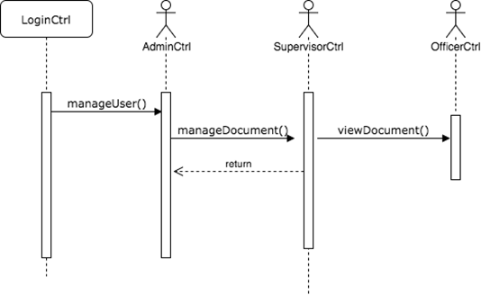
Insert sequence diagram

Slide 48
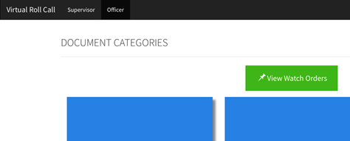
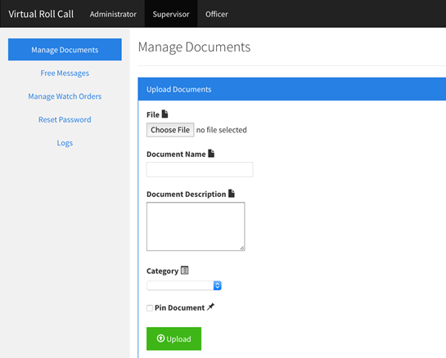
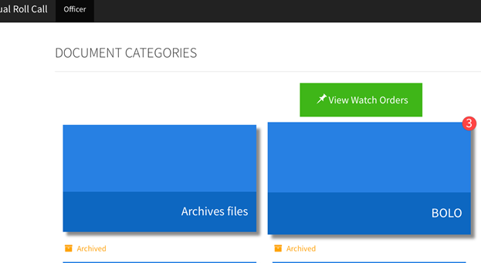
Insert screenshot
Notes:
20 seconds
The tile of user story
Please present and show the complexity of your work, code, algorithms, and technical challenges and technologies you have used. (you could use screenshot if you want. Visual presentations are better than text presentation) - Go into the details of the most important/significant tasks using bullet lists or visual graphs or state chart diagram - Demo using screenshots or GIF (in another separate page if required)
Sequence Diagram for this user story is optional

Slide 49
Sprint 5
Juan Lopez
Story # 304: Add Watch Order
Story # 306: Delete Watch Order
Story # 307: Edit Watch Order
Jean Faustin
Story # 248: Add Text Information
Story # 308: Edit Free Message

Slide 50
User Story #304: Add Watch Order
As a supervisor, I would like to a single watch order into the system instead of using a CSV file, so that it can later be viewed by officers.
A watch order consists of a description, address, longitude, latitude, and the date when it was added.
The add watch order form must have two fields: description and address.
If the user submits the form with empty fields, an error message should be displayed.
A notification should be displayed after attempting to add watch order, indicating if the watch order was added to the database.
Notes:
60 seconds
The tile of user story
The most important user story you worked on it. You have to describe this one very well and be proud of that.
Please present and show the complexity of your work, code, algorithms, and technical challenges and technologies you have used. (you could use screenshot if you want. Visual presentations are better than text presentation)
Go into the details of the most important/significant tasks using bullet lists or visual graphs or state chart diagram
Sequence Diagram for this user story is mandatory (in another separate page if required)
Demo using screenshots or GIF (in another separate page if required)

Slide 51
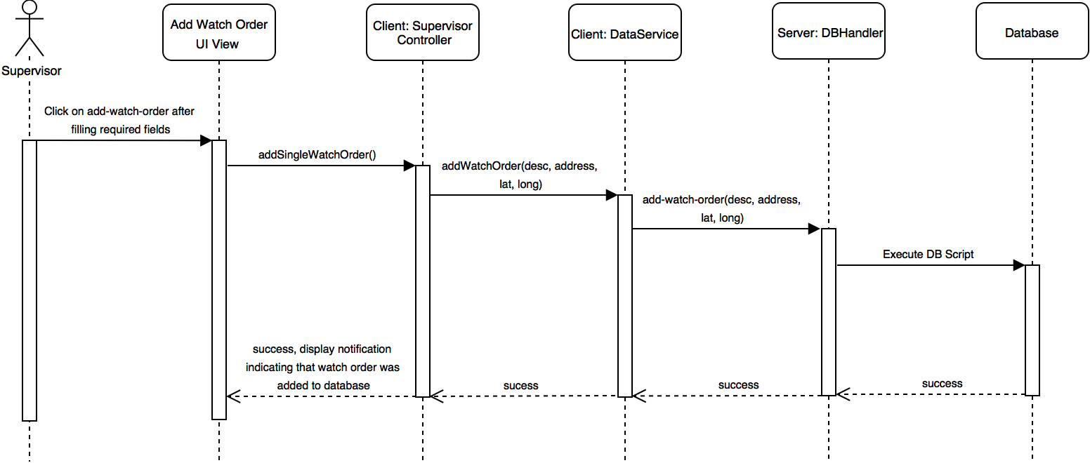

Slide 52
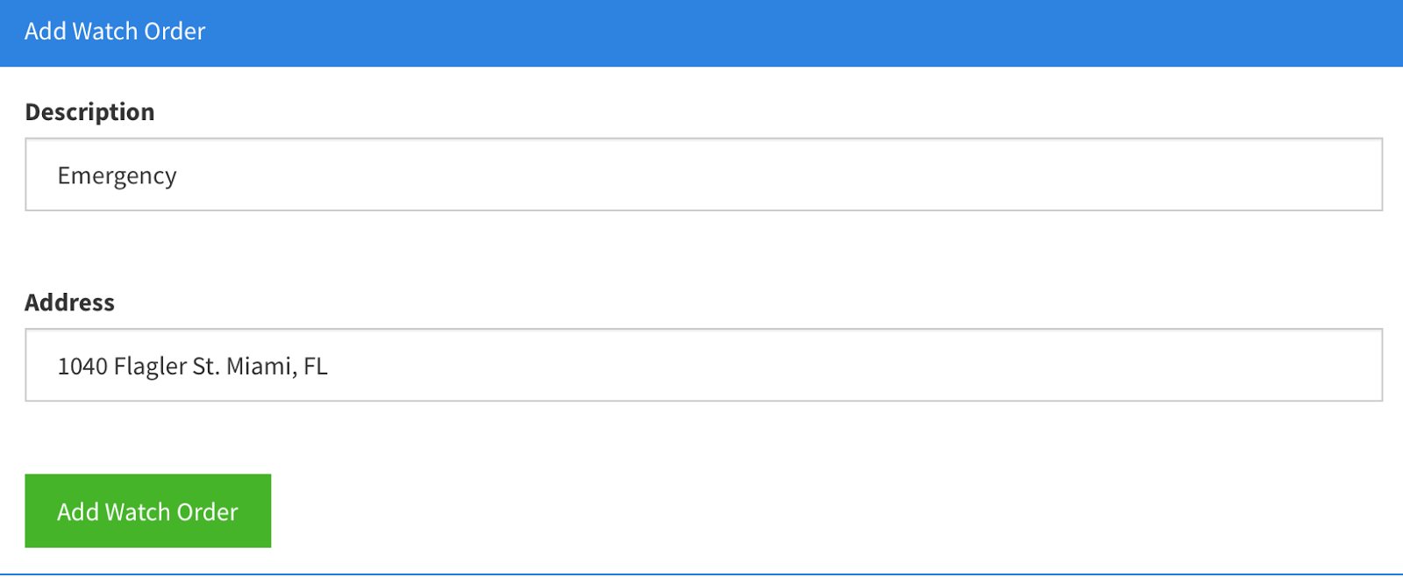
Notes:
20 seconds
The tile of user story
Please present and show the complexity of your work, code, algorithms, and technical challenges and technologies you have used. (you could use screenshot if you want. Visual presentations are better than text presentation) - Go into the details of the most important/significant tasks using bullet lists or visual graphs or state chart diagram - Demo using screenshots or GIF (in another separate page if required)
Sequence Diagram for this user story is optional

Slide 53
User Story #306: Delete Watch Order
As a supervisor, I would like to delete watch orders, so that invalid or old watch orders can be removed from the system
A watch order consists of a description, address, longitude, latitude, and the date when it was added.
The add watch order form must have two fields: description and address.
If the user submits the form with empty fields, an error message should be displayed.
A notification should be displayed after attempting to add watch order, indicating if the watch order was added to the database.
Notes:
60 seconds
The tile of user story
The most important user story you worked on it. You have to describe this one very well and be proud of that.
Please present and show the complexity of your work, code, algorithms, and technical challenges and technologies you have used. (you could use screenshot if you want. Visual presentations are better than text presentation)
Go into the details of the most important/significant tasks using bullet lists or visual graphs or state chart diagram
Sequence Diagram for this user story is mandatory (in another separate page if required)
Demo using screenshots or GIF (in another separate page if required)

Slide 54
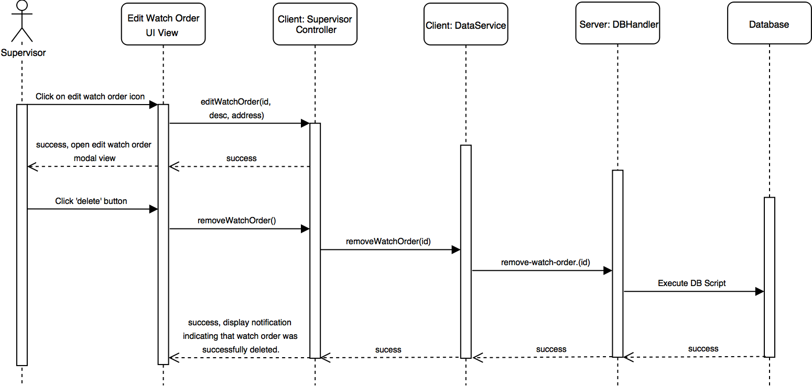

Slide 55
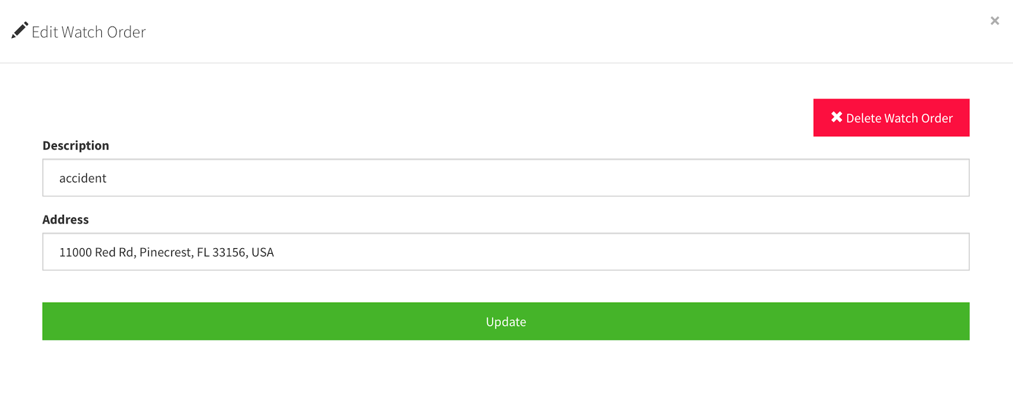
Notes:
20 seconds
The tile of user story
Please present and show the complexity of your work, code, algorithms, and technical challenges and technologies you have used. (you could use screenshot if you want. Visual presentations are better than text presentation) - Go into the details of the most important/significant tasks using bullet lists or visual graphs or state chart diagram - Demo using screenshots or GIF (in another separate page if required)
Sequence Diagram for this user story is optional

Slide 56
User Story #307: Edit Watch Order
As a supervisor, I would like to edit specific watch orders because certain properties may be incorrect or outdated.
The supervisor must be able to edit any watch order.
If a watch order is successfully edited, the system must display a success message.
If a watch order cannot be edited, the system must display an error message.
Notes:
60 seconds
The tile of user story
The most important user story you worked on it. You have to describe this one very well and be proud of that.
Please present and show the complexity of your work, code, algorithms, and technical challenges and technologies you have used. (you could use screenshot if you want. Visual presentations are better than text presentation)
Go into the details of the most important/significant tasks using bullet lists or visual graphs or state chart diagram
Sequence Diagram for this user story is mandatory (in another separate page if required)
Demo using screenshots or GIF (in another separate page if required)

Slide 57
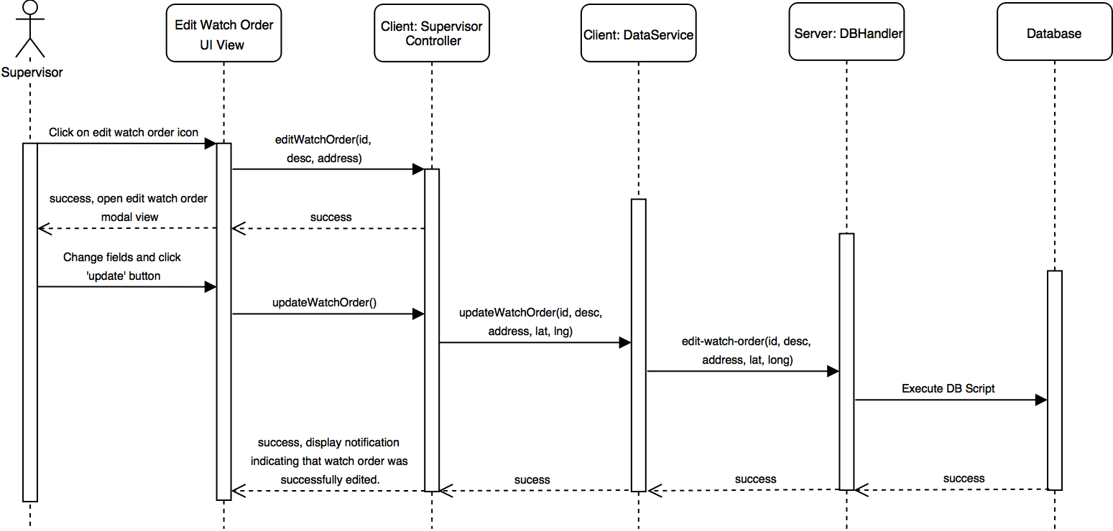

Slide 58
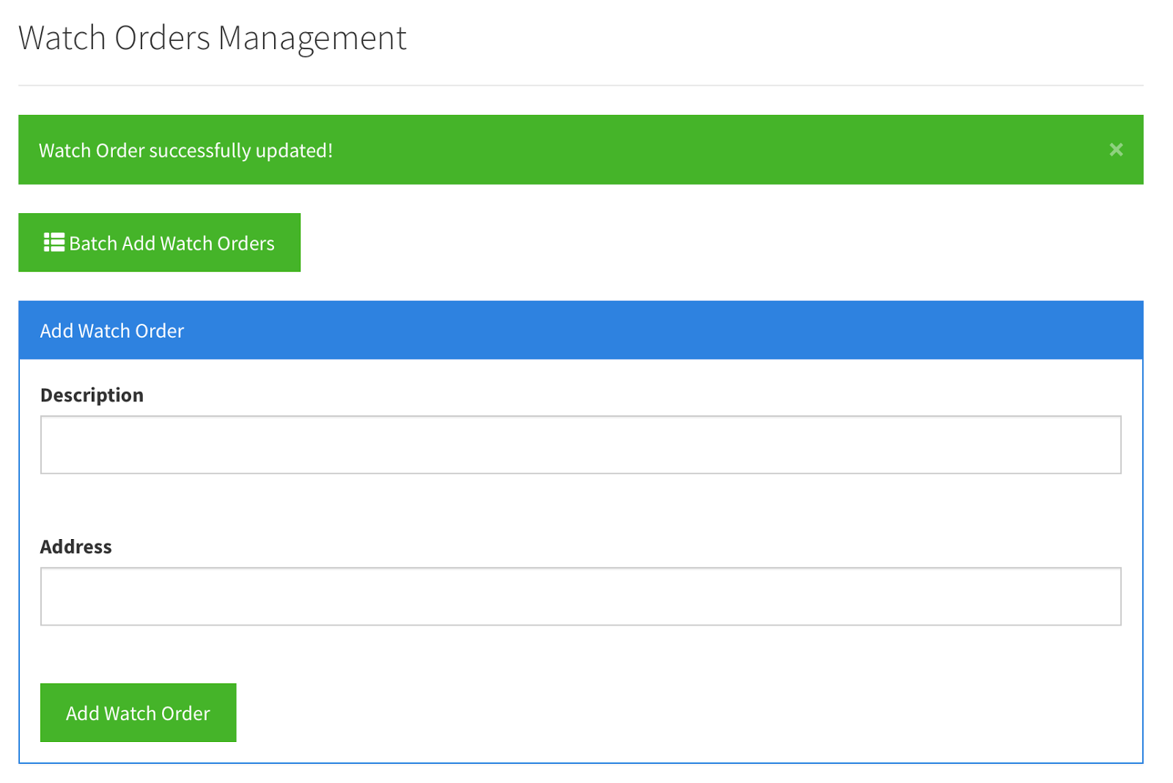
Notes:
20 seconds
The tile of user story
Please present and show the complexity of your work, code, algorithms, and technical challenges and technologies you have used. (you could use screenshot if you want. Visual presentations are better than text presentation) - Go into the details of the most important/significant tasks using bullet lists or visual graphs or state chart diagram - Demo using screenshots or GIF (in another separate page if required)
Sequence Diagram for this user story is optional

Slide 59
User Story #248: Add Free-Text Messages
As a supervisor, I would like to be able to input updates into a free form text box so that I can share information with officers that doesn’t necessarily exist in a document form.
The plain-message must be short.
The message must be archived after seven (7) days.
An officer should be allowed to pin the message.
A notification should be sent upon new messages.
Notes:
60 seconds
The tile of user story
The most important user story you worked on it. You have to describe this one very well and be proud of that.
Please present and show the complexity of your work, code, algorithms, and technical challenges and technologies you have used. (you could use screenshot if you want. Visual presentations are better than text presentation)
Go into the details of the most important/significant tasks using bullet lists or visual graphs or state chart diagram
Sequence Diagram for this user story is mandatory (in another separate page if required)
Demo using screenshots or GIF (in another separate page if required)

Slide 60
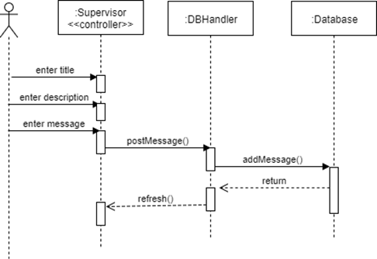
Insert sequence diagram

Slide 61
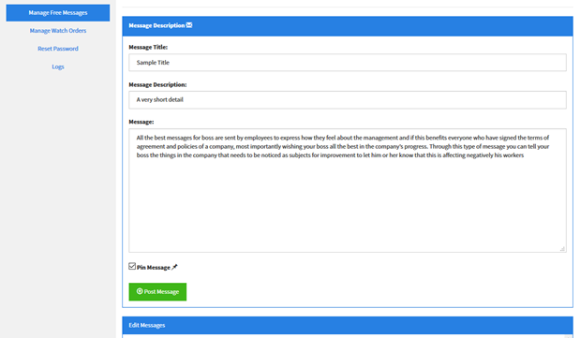
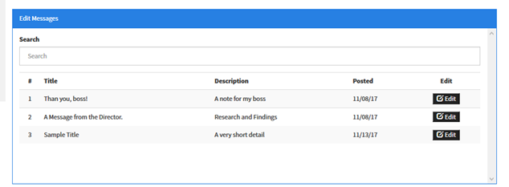
Insert screenshot
Notes:
20 seconds
The tile of user story
Please present and show the complexity of your work, code, algorithms, and technical challenges and technologies you have used. (you could use screenshot if you want. Visual presentations are better than text presentation) - Go into the details of the most important/significant tasks using bullet lists or visual graphs or state chart diagram - Demo using screenshots or GIF (in another separate page if required)
Sequence Diagram for this user story is optional

Slide 62
User Story #308: Edit Free-Text Messages
As a supervisor, I would like to be able to edit free-form text box so that I can update or add additional information or delete the entire message.
● The edited message should have a title. ● The edited message should have a description. ● The message body should not be empty. ● The user should be able to delete the message
from the list.
Notes:
60 seconds
The tile of user story
The most important user story you worked on it. You have to describe this one very well and be proud of that.
Please present and show the complexity of your work, code, algorithms, and technical challenges and technologies you have used. (you could use screenshot if you want. Visual presentations are better than text presentation)
Go into the details of the most important/significant tasks using bullet lists or visual graphs or state chart diagram
Sequence Diagram for this user story is mandatory (in another separate page if required)
Demo using screenshots or GIF (in another separate page if required)

Slide 63
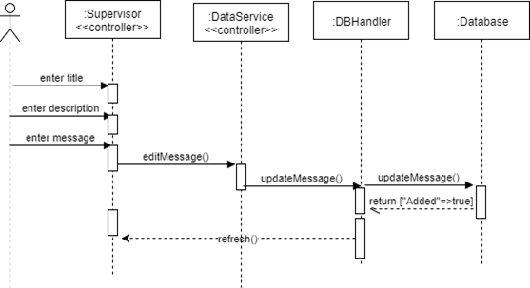
Insert sequence diagram

Slide 64
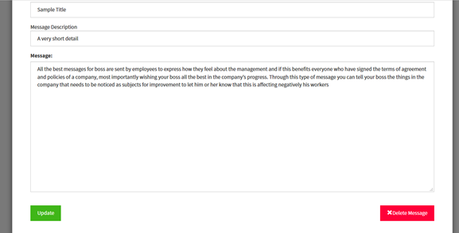
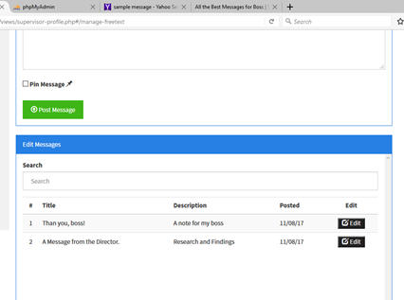
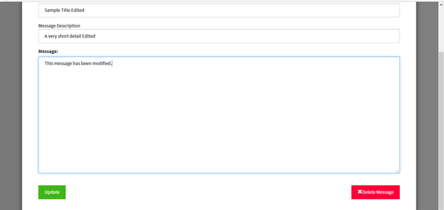
Insert screenshot
Notes:
20 seconds
The tile of user story
Please present and show the complexity of your work, code, algorithms, and technical challenges and technologies you have used. (you could use screenshot if you want. Visual presentations are better than text presentation) - Go into the details of the most important/significant tasks using bullet lists or visual graphs or state chart diagram - Demo using screenshots or GIF (in another separate page if required)
Sequence Diagram for this user story is optional

Slide 65
Sprint 6
Juan Lopez
Story # 309: Automatically Delete Watch Order
Story # 310: Display Watch Order List Table
Jean Faustin
Story # 243: Add Document Quiz
Story # 312: Take Quiz

Slide 66
User Story #309: Automatically Delete Watch Orders
As a supervisor, I would like for watch orders to be automatically deleted based on their expiration date, so that outdated watch orders are not present in the system.
If the current date is before the expiration date, the watch order should not be deleted.
If the current date is past the expiration date, the watch order should be deleted.
Watch orders past their expiration date should never be visible to either supervisors or officers.
Notes:
60 seconds
The tile of user story
The most important user story you worked on it. You have to describe this one very well and be proud of that.
Please present and show the complexity of your work, code, algorithms, and technical challenges and technologies you have used. (you could use screenshot if you want. Visual presentations are better than text presentation)
Go into the details of the most important/significant tasks using bullet lists or visual graphs or state chart diagram
Sequence Diagram for this user story is mandatory (in another separate page if required)
Demo using screenshots or GIF (in another separate page if required)

Slide 67
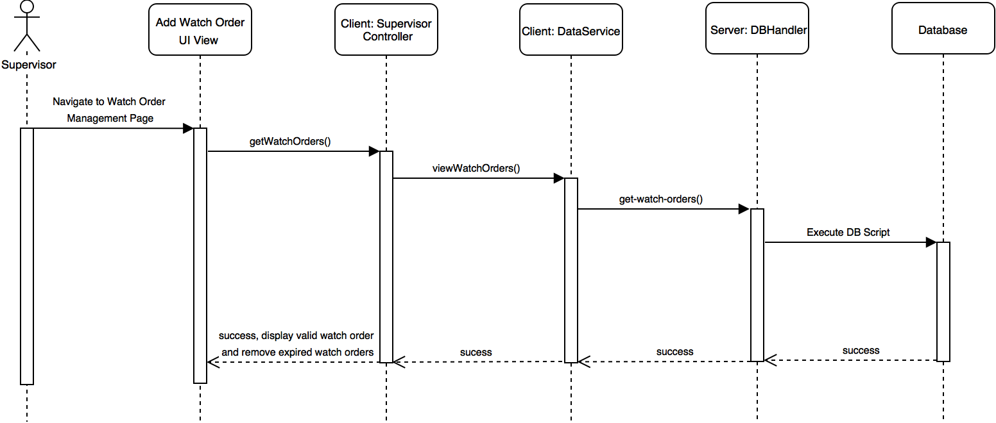

Slide 68
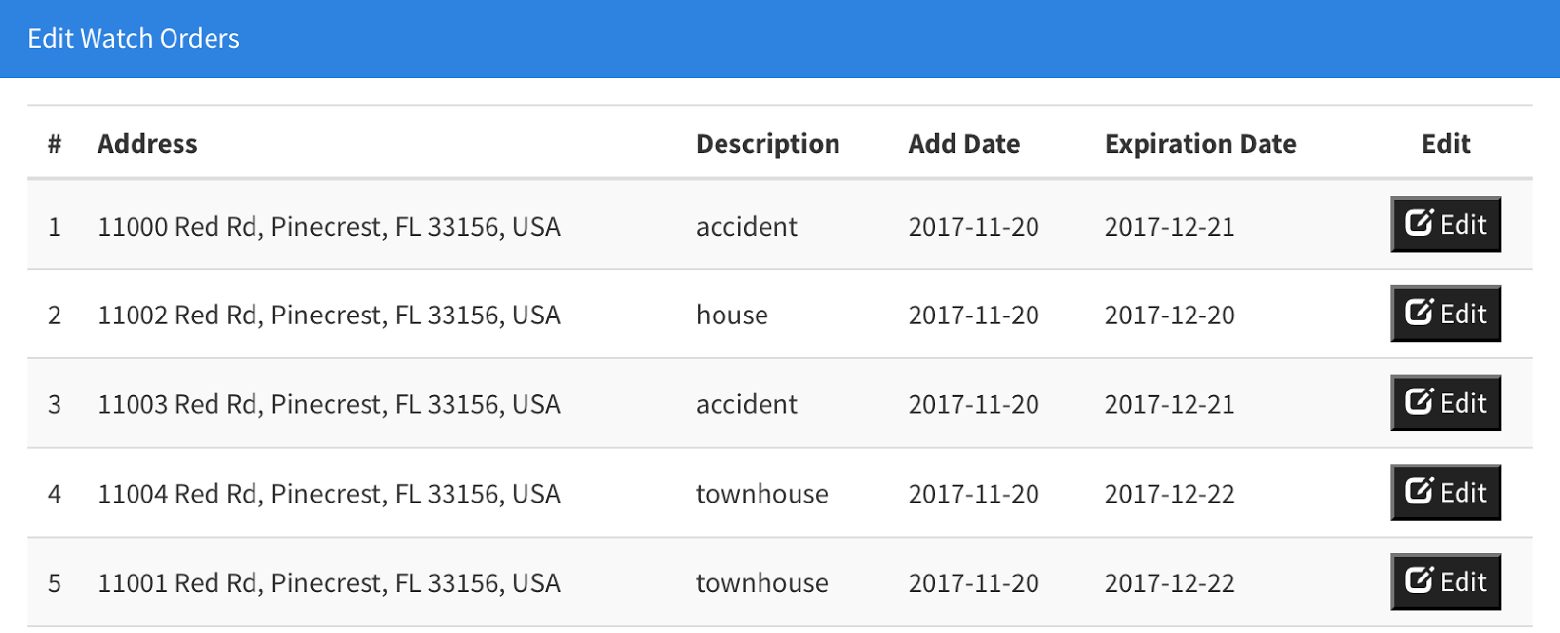
Notes:
20 seconds
The tile of user story
Please present and show the complexity of your work, code, algorithms, and technical challenges and technologies you have used. (you could use screenshot if you want. Visual presentations are better than text presentation) - Go into the details of the most important/significant tasks using bullet lists or visual graphs or state chart diagram - Demo using screenshots or GIF (in another separate page if required)
Sequence Diagram for this user story is optional

Slide 69
User Story #310: Display Watch Order List Table
As an officer, I would like to see a table list of watch orders so that I can quickly search for watch orders instead of having to examine the map.
All watch orders visible in the map should also be listed in the table.
The table must display the following fields for each watch order: address, description, add date, and expiration date.
The watch orders listed in the table can only be viewed, not modified.
Notes:
60 seconds
The tile of user story
The most important user story you worked on it. You have to describe this one very well and be proud of that.
Please present and show the complexity of your work, code, algorithms, and technical challenges and technologies you have used. (you could use screenshot if you want. Visual presentations are better than text presentation)
Go into the details of the most important/significant tasks using bullet lists or visual graphs or state chart diagram
Sequence Diagram for this user story is mandatory (in another separate page if required)
Demo using screenshots or GIF (in another separate page if required)

Slide 71
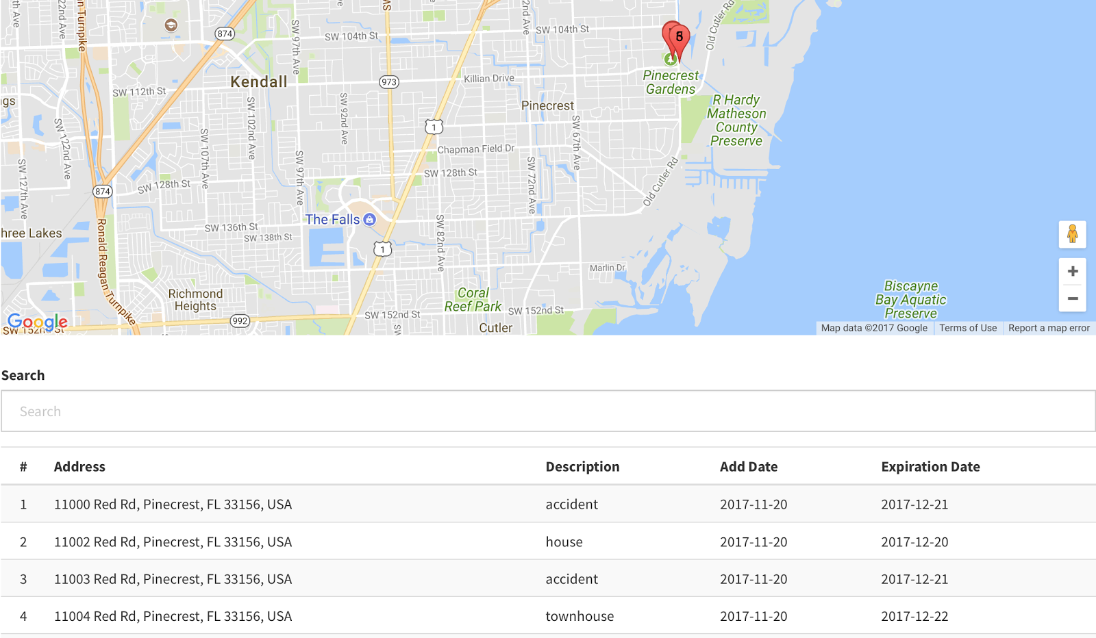
Notes:
20 seconds
The tile of user story
Please present and show the complexity of your work, code, algorithms, and technical challenges and technologies you have used. (you could use screenshot if you want. Visual presentations are better than text presentation) - Go into the details of the most important/significant tasks using bullet lists or visual graphs or state chart diagram - Demo using screenshots or GIF (in another separate page if required)
Sequence Diagram for this user story is optional

Slide 72
User Story #243: Add Document Quiz
As a Supervisor, I should be able to set pop quizzes to help center key points in documents and messages, or to verify the document was read.
There should be at most five (5) questions per quiz.
The quiz should not be timed.
If a document has a quiz, Done status is marked until the quiz is taken.
A scoring message should be displayed after taking the quiz.
There is no repeat for the quiz.
Notes:
60 seconds
The tile of user story
The most important user story you worked on it. You have to describe this one very well and be proud of that.
Please present and show the complexity of your work, code, algorithms, and technical challenges and technologies you have used. (you could use screenshot if you want. Visual presentations are better than text presentation)
Go into the details of the most important/significant tasks using bullet lists or visual graphs or state chart diagram
Sequence Diagram for this user story is mandatory (in another separate page if required)
Demo using screenshots or GIF (in another separate page if required)

Slide 73
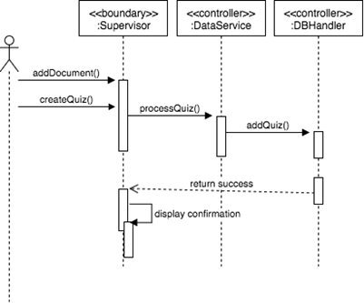
Insert sequence diagram

Slide 74


Insert screenshot
Notes:
20 seconds
The tile of user story
Please present and show the complexity of your work, code, algorithms, and technical challenges and technologies you have used. (you could use screenshot if you want. Visual presentations are better than text presentation) - Go into the details of the most important/significant tasks using bullet lists or visual graphs or state chart diagram - Demo using screenshots or GIF (in another separate page if required)
Sequence Diagram for this user story is optional

Slide 75
User Story #312: Take Quiz
As a Supervisor, I should be able to set pop quizzes to help center key points in documents and messages, or to verify the document was read.
The quiz is of multiple choices.
The quiz is only available once.
The document status is updated after taking the test.
The test can only be taken or viewed after the document has been reviewed.
Notes:
60 seconds
The tile of user story
The most important user story you worked on it. You have to describe this one very well and be proud of that.
Please present and show the complexity of your work, code, algorithms, and technical challenges and technologies you have used. (you could use screenshot if you want. Visual presentations are better than text presentation)
Go into the details of the most important/significant tasks using bullet lists or visual graphs or state chart diagram
Sequence Diagram for this user story is mandatory (in another separate page if required)
Demo using screenshots or GIF (in another separate page if required)

Slide 76

Insert sequence diagram

Slide 77



Insert screenshot
Notes:
20 seconds
The tile of user story
Please present and show the complexity of your work, code, algorithms, and technical challenges and technologies you have used. (you could use screenshot if you want. Visual presentations are better than text presentation) - Go into the details of the most important/significant tasks using bullet lists or visual graphs or state chart diagram - Demo using screenshots or GIF (in another separate page if required)
Sequence Diagram for this user story is optional

Slide 78
Shortcomings/ Wishlist
User Story #311: Change Map Position Based on Selected Watch Order
As an officer, I would like for the watch order map position to change based on the selected watch order from the list table.
Notes:
10 seconds.
Introduce the problem that the whole project (in all versions) tackles with GIF or screenshot.

Slide 79
Shortcomings/ Wishlist
User Story #313: Highlight Selected Watch Order
As an officer, I would like for a selected watch order from the map to be highlighted in the watch order list table, so I can quickly locate a watch order in the list.
Notes:
10 seconds.
Introduce the problem that the whole project (in all versions) tackles with GIF or screenshot.

Slide 80
Shortcomings/ Wishlist
User Story #314: Change Document Order Based on Officer Preference
As an officer, I would like to several options to change the order in which documents are displayed, so I that I can choose the best ordering for my needs.
Notes:
10 seconds.
Introduce the problem that the whole project (in all versions) tackles with GIF or screenshot.

Slide 81
Shortcomings/ Wishlist
User Story #315: Add Real-time Chat Messages
As a supervisor, I would like to send a chat message to all officers, so I can get immediate feedback from any officer.
Notes:
10 seconds.
Introduce the problem that the whole project (in all versions) tackles with GIF or screenshot.

Slide 82
Shortcomings/ Wishlist
User Story #316: Add Voice Messages
As a supervisor, I would like to upload voice messages, so that I can send audio information to officers.
Notes:
10 seconds.
Introduce the problem that the whole project (in all versions) tackles with GIF or screenshot.

Slide 83
Shortcomings/ Wishlist
User Story #317: Improve Password Security
As an administrator, I would like to have stronger password requirements to improve the general security of the application.
Notes:
10 seconds.
Introduce the problem that the whole project (in all versions) tackles with GIF or screenshot.

Slide 84
Shortcomings/ Wishlist
User Story #318: Close Window Session
As an officer, I want to close the window session after I log out so that I don’t preserve access across multiple pages.
Notes:
10 seconds.
Introduce the problem that the whole project (in all versions) tackles with GIF or screenshot.

Slide 85




Summary
Enhanced application visual design
Added ability to add users and watch orders with a CSV file
Improved application security
Added ability to view and manage watch orders
Created application distribution package
Added ability to view and manage text information
Added ability to create and take document quizzes
Contact
Juan Lopez (jlope518@fiu.edu)
Jean Faustin (jfaus004@fiu.edu )
Questions?
Thank You!
Notes:
10 seconds
Summarize your contribution, mention your effort for Scrum, Mingle, Github, Google Drive Documentation and minutes
Include your contact information
Ask if anyone has any questions for you.
Thank your audience

